Slide 1
Semantics &
Sentiment Analysis
Renato R. Maaliw III, DIT
College of Engineering
Southern Luzon State University
Lucban, Quezon, Philippines

Slide 2
Word2vec is a two-layer neural net that processes text
Its input is a text corpus and its output is a set of vectors: feature vectors for words in that corpus

Slide 3
The purpose and usefulness of Word2vec is to group the vectors of similar words together in vector space
That is, it detects similarities mathematically

Slide 4
Word2vec creates vectors that are distributed numerical representations of word feature, features such as the context of individual words
It does so without human intervention

Slide 5
Given enough data, usage and contexts, Word2vec can make highly accurate guesses about a word’s meaning based on past appearances
Example: “man” is to “boy” what “woman” is to “girl”

Slide 6
Word2vec trains words against other words that neighbor them in the input corpus
Either using context to predict a target word (continuous bagging of words - CBOW) or using a word to predict a target context (skip-gram)

Slide 7
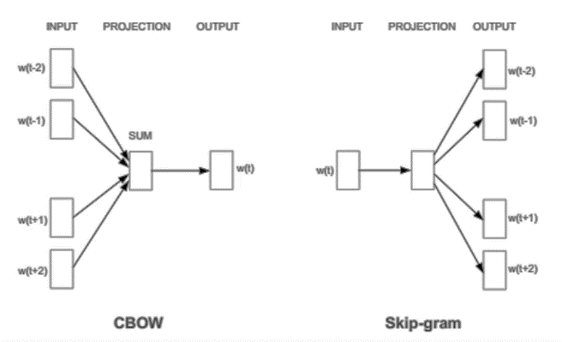
Two possible approaches

Slide 8
Each word is now represented by a vector
In SpaCy, vectors has 300 dimensions

Slide 9
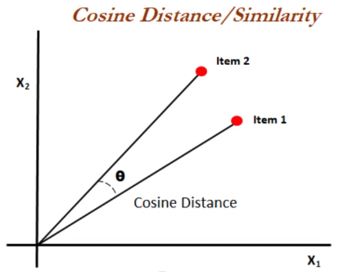
This means we can use Cosine Similarity to measure how similar word vectors are to each other

Slide 10
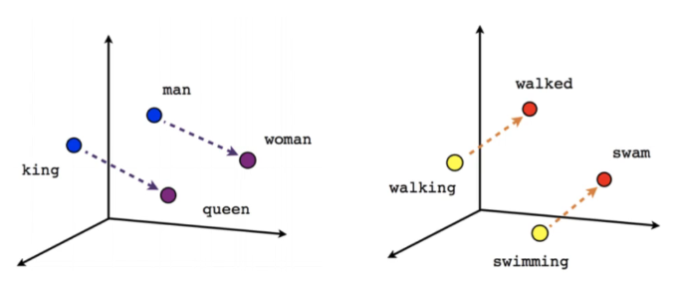
Interesting relationships can be established between the word vectors

Slide 11
[CODE DEMO]

Slide 12
Thank you very much for listening.

